Slide 1
Audio Digits Classification
Presented By
Jay Bendre
Ignat Kulinka
Ran Ma

Slide 2
Introduction
Speech recognition: an interdisciplinary subfield between computer science and linguistics.
Feature extraction, recognition and classification
Audio Digits Classification
Audio MNIST dataset
Does classification really need Deep Learning?

Slide 3
Data Description
Audio MNIST dataset
Available at https://github.com/soerenab/AudioMNIST
Audio Sample: 30,000 audio samples of spoken digits (0-9) by 60 different speakers
Speaker Metadata: Information on the age, gender, origin, and accent of each of the 60 speakers.

Slide 4
Methodology
Convolutional Neural Network
Linear Support Vector Machine
Long Short-Term Memory Model

Slide 5
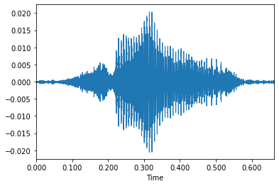
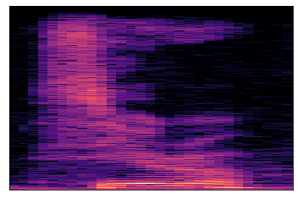
Data Preprocessing
Convert recordings into pictorial representations
Waveform V.S. spectrogram (spectrogram selected for this project)
For each recording, 22,050Hz short-time Fourier transform spectrogram images (zero padded, size 235 x 352)

Slide 6
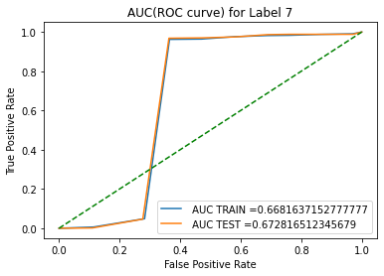
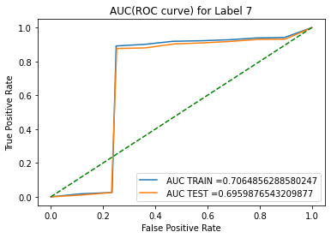
Empirical Analysis - SVC
Input: raw audio data in floating point format
For convergence, hyperparameter tuned by GridSearch
C = 1, γ = 0.01, kernels =`poly’ is chosen
Results:
~86% accuracy on test data
`Best’ classified: 7 (93%)
`Worst’ classified: 2 (78%)

Slide 7
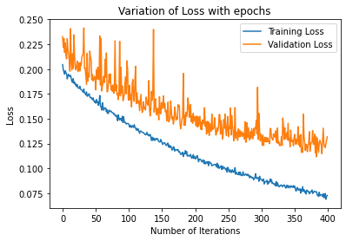
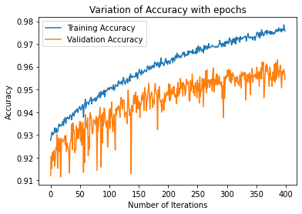
Empirical Analysis - LSTM
Input: Spectrograms
Architecture
LSTM layer followed by Fully connected ReLu Layers
Results
~ 95% Accuracy on the testing data
Downside
Lack of interpretability
Potential Overfitting issues.
Notes:
Start with a LSTM layer with 500 neurons -> FC layers of size 120, 60 and 10 with ReLu activation
Per-epoch time of under 20ms
See loss converging to 0 -> could potentially overfit the data

Slide 8
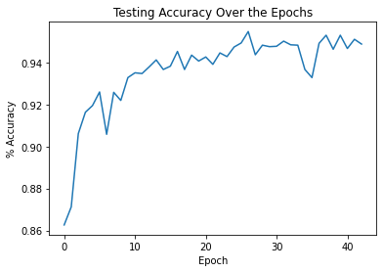
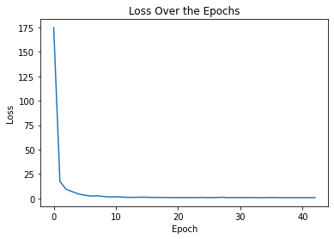
Empirical Analysis - CNN
Input: spectrograms
Slightly modified AlexNet architecture
Results:
~95% accuracy on test data
Downsides:
10+ hour training time
Lack of interpretability
Notes:
Fully connected layers are 1024, 1024 and then 10

Slide 9
Conclusion
ML v/s Deep Learning: no clear winner
Very hard to clearly say which method is better at audio classification
Lightweight use cases: SVMs
Mobile application requiring basic classification tasks for ex: Siri, Google Assistant
Heavy computational power: Neural Networks
Transcription of videos in streaming services like Netflix, Hulu etc.
Notes:
A very use-case dependent answer to the question
Simple segregation task of handling smart home activities for ex: can be even handled with decent accuracy by SVMs
Heavy tasks which require accurate transcription like netflix or language translation would require Neural networks

Slide 10
Further Discussion
Data Processing - improve quality of input images
Different window sizes for the short-time Fourier transform
Impact of cloud-based training
Makes interpreting results significantly easier.

Slide 11
Thank you!
Presented By
Jay Bendre
Ignat Kulinka
Ran Ma

